Slide 1


Where does the English language come from?
LO: To understand the diverse origins of the modern English language, including its Latin and Ancient Greek roots

Slide 2
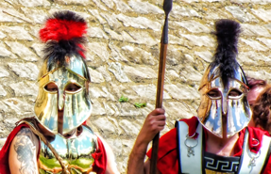
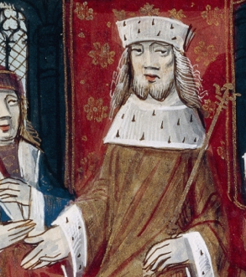
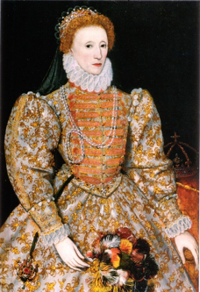

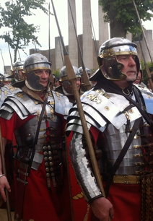

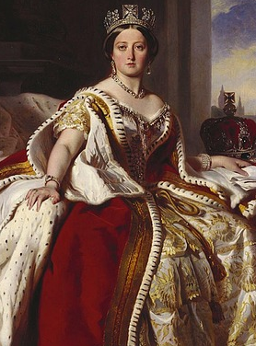
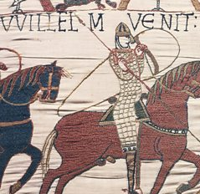
Rome and Ancient Greece : from here to there
Ancient Greece 1000 BCE -
31 BCE
Elizabethan era 1558-1603
Modern times
Anglo Saxon era
410 -1066
Victorian era
1837-1901
Ancient Rome
1st Century BCE - 5th Century CE
Norman conquest & Middle Ages
1066-1485
1. Where does the English language come from?

Slide 3
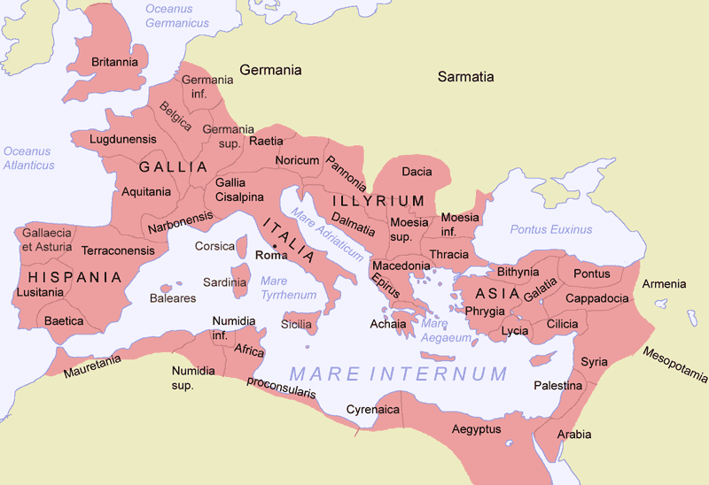
The Roman Empire in 117 C.E. : anything familiar?
🤓💬
1. Where does the English language come from?

Slide 4
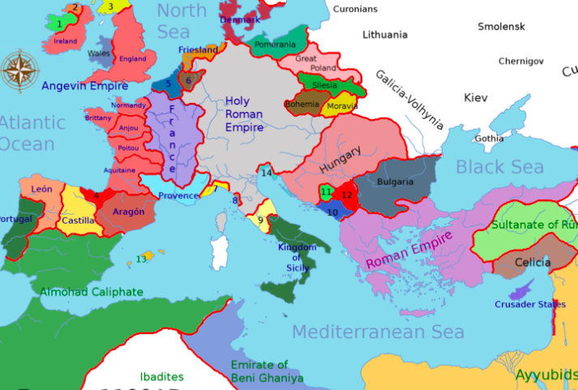
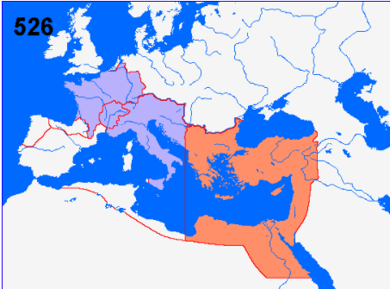

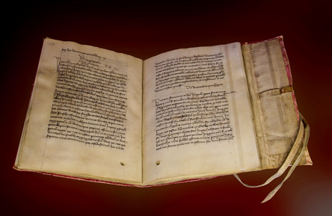
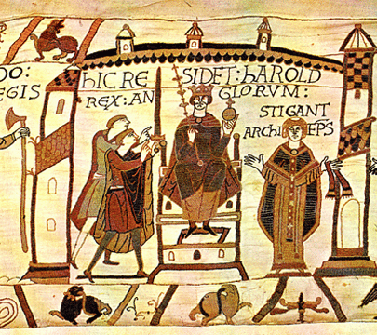
How did English speakers (that’s you!) end up speaking Latin?
1st – 4th Centuries C.E.
5th- 10th Centuries C.E.
1066 C.E.
1. Where does the English language come from?

Slide 5
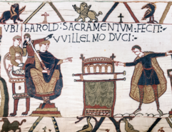


The roots of the English language
telephone
khaki
thermometer
geography
shampoo
jungle
Hindi
Ancient Greek
Arabic
FRENCH
beef
candy
orange
ghoul
animate
pedestrian
1066 CE
the Norman French conquest
ANGLO SAXON
Latin
pedes
daughter
anima
bos
6th-10th centuries CE
Anglo-Saxon settlement and Norse invasion of Britain
sword
27 BCE - 476 CE
The Roman Empire
cow
1. Where does the English language come from?

Slide 6



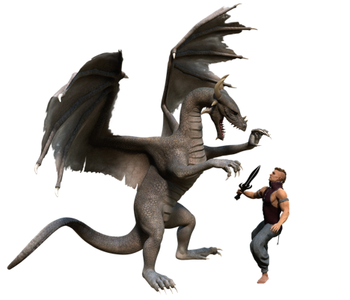
Finding the Latin all around us
schola
villa
finis
bestia
📝
1. Where does the English language come from?

Slide 7
Plenary quiz
Question 1 After the Romans left Britain, who brought a form of the Latin language back here when they conquered England? Can you remember which year this happened?
Question 2 What English word do we get from the Latin word ‘finis’ meaning ‘end’? Can you think of any more?
Question 3 What other languages’ influence can be found in English?
1. Where does the English language come from?

